Slide 1

Experimental measurements and model studies on scattering properties of smoke particles
Qixing Zhang, Feng Wang, Jie Luo
State Key Laboratory of Fire Science, University of Science & Technology of China, PR China
Notes:
Good morning, everyone
I come from State key laboratory of fire science of university of science and technology of china
I’m happy to introduce our works on the experimental measurements and model studies on scattering properties of smoke particles

Slide 2
Outline
Motivation
Experimental measurement
model study
summary
Notes:
My talk will be divided into four parts.
The first part is motivation.

Slide 3
Motivation
Important for atmospheric remote sensing, climate change studies and fire detection etc.
The optical properties of smoke particles may be diverse in different combustion conditions.
Mie theory are often used in climate model. But it may be not applicable in many cases. So we verified the applicability of Mie and studied the optical properties of non-spherical particles.
With the atmospheric aging, soot particles tend to be coated with non-absorbing materials, which leads to more complex morphology of soot particles

Slide 4
Experimental measurement
Scattering and Stokes Parameters
Light beam can be represented by four Stokes parameters
total intensity
± 90º polarization
± 45º polarization
circular polarization
Notes:
The second part is Experimental measurement. Light beam can be presented by four Stokes parameters. Where the first element reflects the total intensity, the second element reflects positive and negative 90 degree polarization, the third element represent positive and negative 45 degree polarization, and the last element reflect circular polarization.

Slide 5
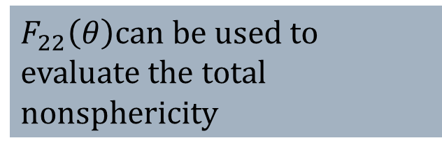
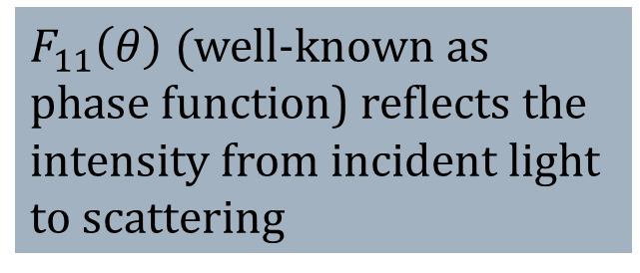
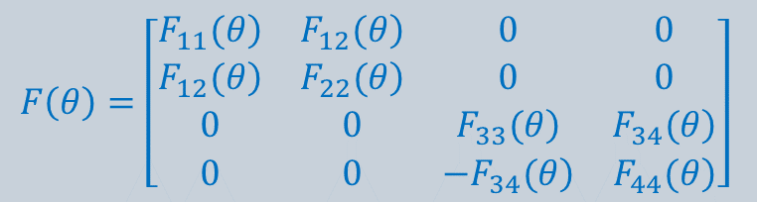
Experimental measurement
Mueller matrix
The transformation from incident light to scattering light can be represented by Mueller matrix:
Scattering matrix
Measurement and
Modeling
$F_{11}\left(θ\right) ($well-known as phase function) reflects the intensity from incident light to scattering
$$F\left(θ\right)=\left[\begin{matrix}\left.F_{11}(θ\right) & \left.F_{12}(θ\right) & 0 & 0 \\ \left.F_{12}(θ\right) & \left.F_{22}(θ\right) & 0 & 0 \\ 0 & 0 & \left.F_{33}(θ\right) & \left.F_{34}(θ\right) \\ 0 & 0 & \left.{−F}_{34}(θ\right) & \left.F_{44}(θ\right)\end{matrix}\right]$$
$F_{22}\left(θ\right)$can be used to evaluate the total nonsphericity

Slide 6
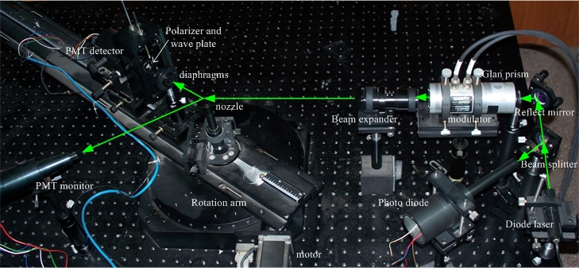
Experimental measurement
Experimental setup
Laser source: diode laser with wavelength of 532 nm
Measurement: 16 elements of Mueller scattering matrix
Scattering angle range: 5°～160°
Angular resolution: 0.0045°
Notes:
That is our experimental set up. Our laser source is diode laser with wavelength of 532 nanometers.

Slide 7
Experimental measurement
Compared with Mie theory
Mie theory is applicable for smoke particles of wood smouldering, but not applicable for flaming
smoke particles of smouldering and flaming wood fire at 532 nm

Slide 8
Experimental measurement
Compared with fractal model

Slide 9
Experimental measurement
Scattering of smokes particles different fuels and different combustion conditions
scotton: smouldering cotton swood: smouldering wood fwood: flaming wood firefheptane: flaming n-heptane
fpolyu: flaming polyurethane.
Notes:
This picture show the Scattering of smokes particles different fuels and different combustion conditions. It can be seen from the picture, the optical properties of smouldering smoke paricles are obviously different from flaming particles. Especially, the S22/S11 of smouldering smoke particles is approximated to 1, which shows smouldering particles present s.pherical characteristics

Slide 10
Experimental measurement
The retrieval of the size distribution and refractive index of spherical particles
Notes:
In addition, we conducted the retrieval of the size distribution and refractive index of spherical particles using Mie theory. We see the error between measurement and simulation results as evaluation function, and change the target parameters via optimization techinique until the error approach to 0.

Slide 11
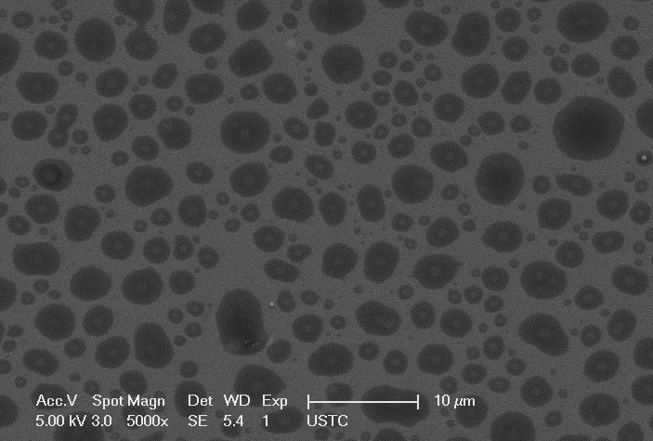
Model study
Image of smoke particulates
Smoldering fire (cotton)
Flaming fire (n-heptane)
Notes:
The third part is model study.From the Image of smoke particulates, we can find the smoldering fire smoke particles is nearly spherical. But the flaming fire particles generally present a fractal structure.

Slide 12
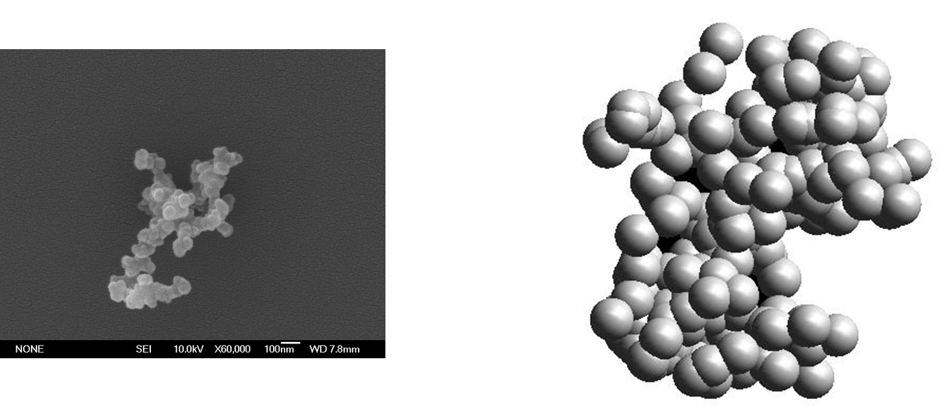
Model study
Fractal model
SEM Image
Fractal model
Notes:
According to the SEM Image of smoke particles, we set up the fractal model, the fractal parameters are gained by analysis of the SEM image.

Slide 13
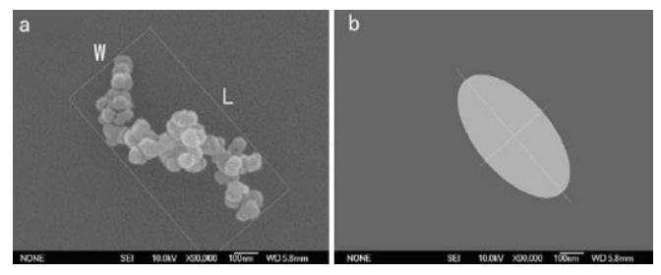
Model study
ellipsoid model
SEM Image
Ellipsoid model
Notes:
According to the SEM image of smoke particles, we found the smoke particles can be represented by Ellipsoid model in some cases.

Slide 14
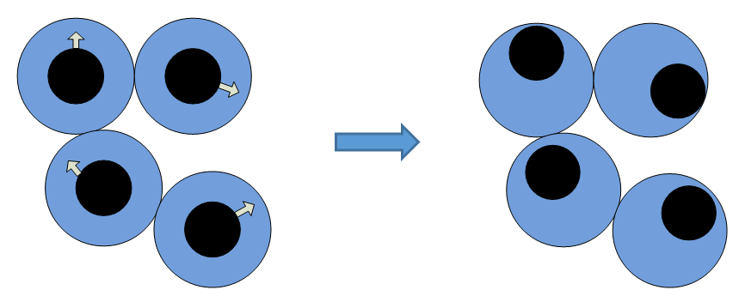
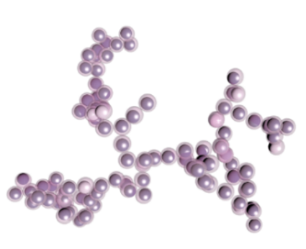
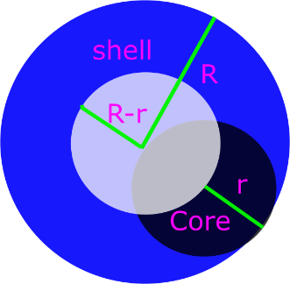
Model study
Study on optical properties of soot particles mixed with non-absorbing materials
Soot particles thinly coated with non-absorbing aerosols are simulated with acentric monomers model
Notes:
Even though the smoke particles generally present a fractal structure, but in atmosphere, the smoke particles ten to be mixed with other materials, which leads to more complex shape. We simulated the thinly coated soot particles with acentric monomers model

Slide 15
Model study
The reason of modeling soot particles with acentric monomers model
In some cases, soot particles are thinly coated, which with nearly core-shell spherical monomers.
Even though previous studies has proposed more complex DDA model about this shape, but the coatings is difficult to control, so it is difficult to understand how the coatings influence the optical properties.
The concentric monomers model is simple, but the coatings are not random.

Slide 16
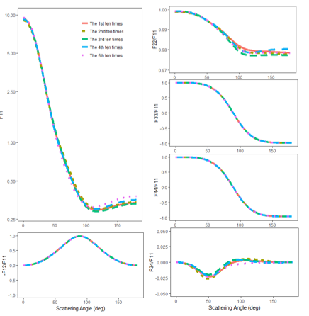
Model study
Scattering matrices using concentric core-shell model, which are randomly averaged for each 10 calculations
We found the error induced by fractal characteristics with identical parameters can not be eliminated by averaging over ten random realizations.
We generated different models based on the identical fractal aggregates

Slide 17
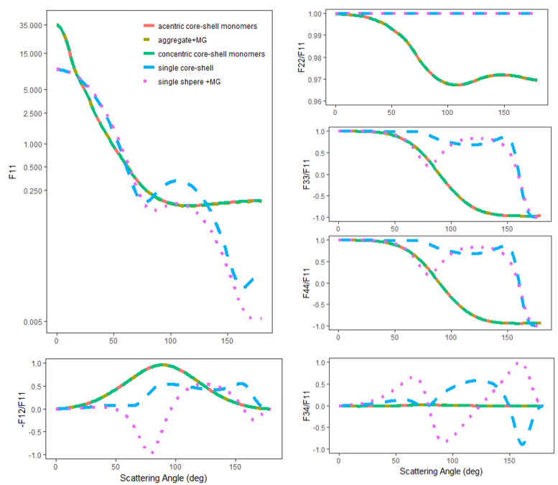
Model study
Scattering matrices calculated with different model N_s=300，Df=1.8，r=0.02um，λ=0.55um, Fsoot=0.2
The results calculated using the acentric core-shell monomers model are significantly different from those with single core-shell model and single equivalent sphere model
Extremely closed to those with concentric core-shell monomers model and homogeneous aggregate model

Slide 18
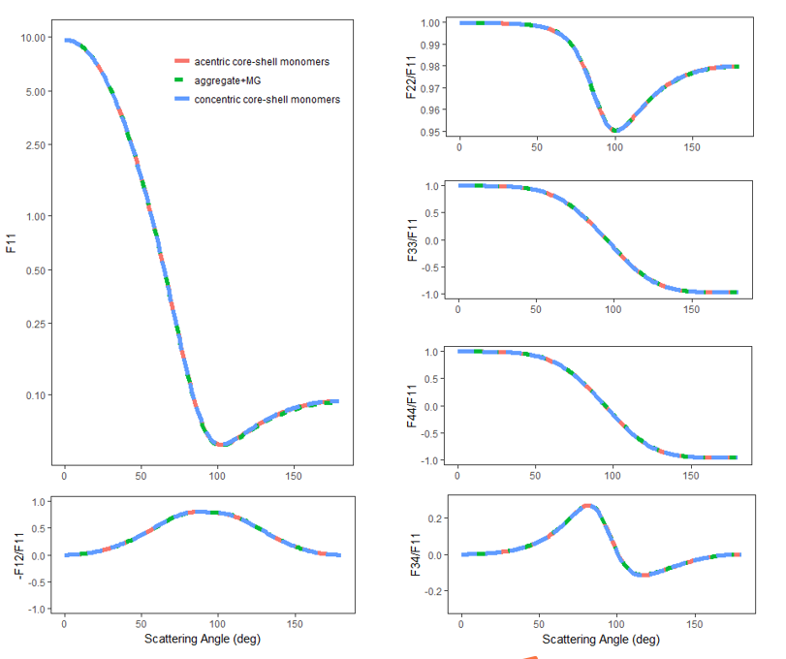
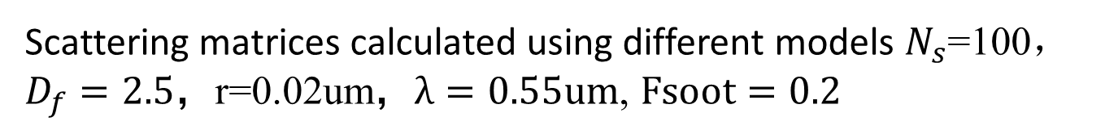
Model study
Scattering matrices calculated using different models $N_{s}$=100，$D_{f}=2.5$，r=0.02um，$λ=0.55um$, $Fsoot=0.2$
The results calculated using the three models are also extremely closed in a more compact cases.
We found the error induced by fractal ec
This results are different from previous studies, in which the results of concentric core-shell monomers model and aggregate +MG model are different
The reason may be that the error in previous study may be caused by fractal nature but not model

Slide 19
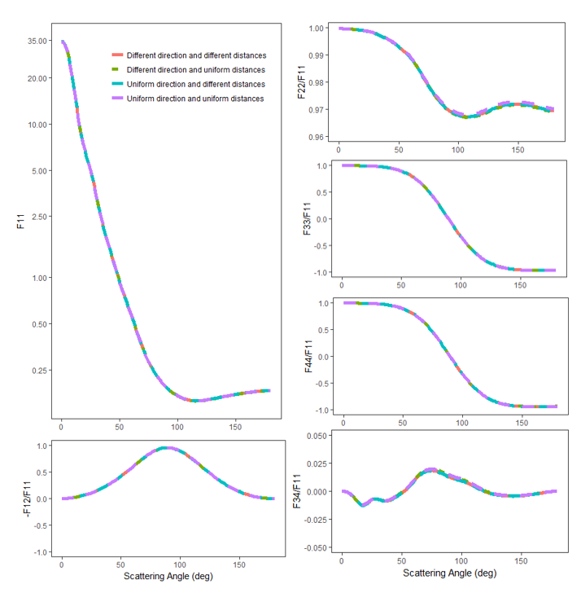
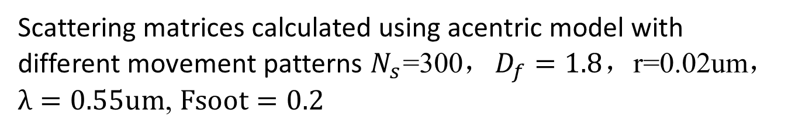
Model study
Scattering matrices calculated using acentric model with different movement patterns $N_{s}$=300，$D_{f}=1.8$，r=0.02um，$λ=0.55um$, $Fsoot=0.2$
the way how the individual primary particles are coated is unimportant for soot particles with a nearly core-shell monomers

Slide 20
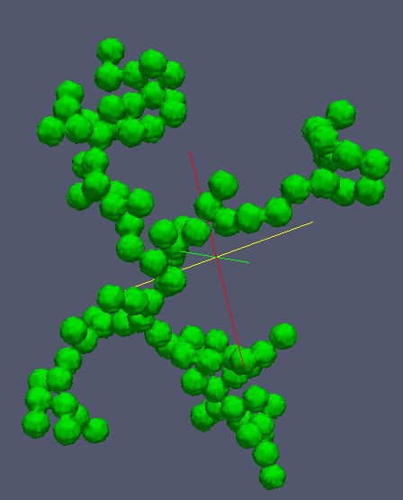
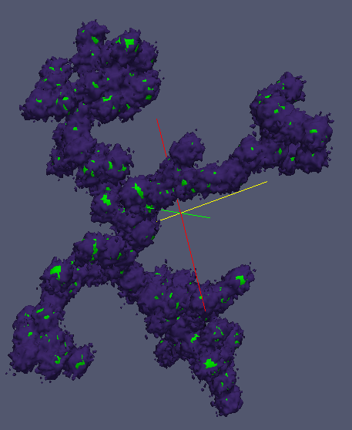
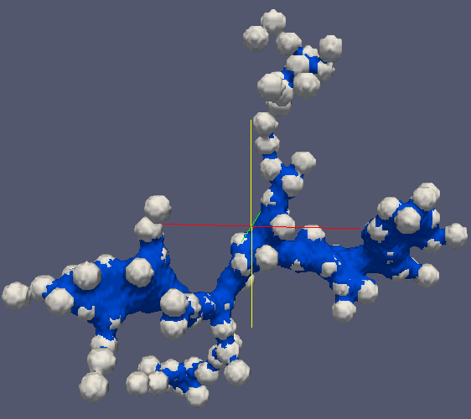
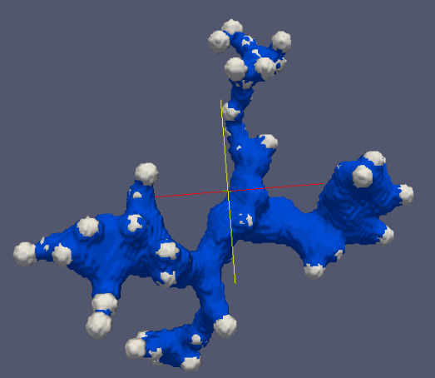
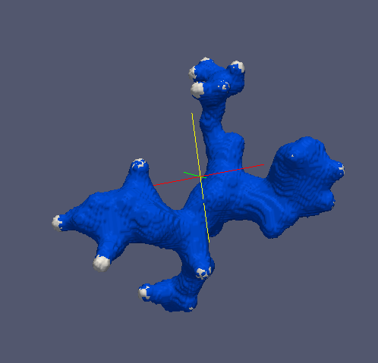
Model study
Works on more realistic models (the codes are written based on previous studies)
We intend to investigate the optical properties of soot particles with more complex morphology in the future

Slide 21
summary
We have set up Scattering platform to measure the scattering matrices of smoke particles
We found the scattering matrices of smoke particles of different fuels are different
We measured the scattering matrices of smoke particles under different combustion conditions, and found the Mie theory is applicable for smouldering smoke particles, but the flaming smoke particle can be simulated with fractal model
We conducted image analysis of shape of smoke particulates, and found smouldering smoke particles are nearly spherical. But the flaming smoke particles generally present fractal structure
We studied the non-spherical model of smoke particles
We start to study the optical properties of soot particles mixed with non-absorbing materials

